Slide 1

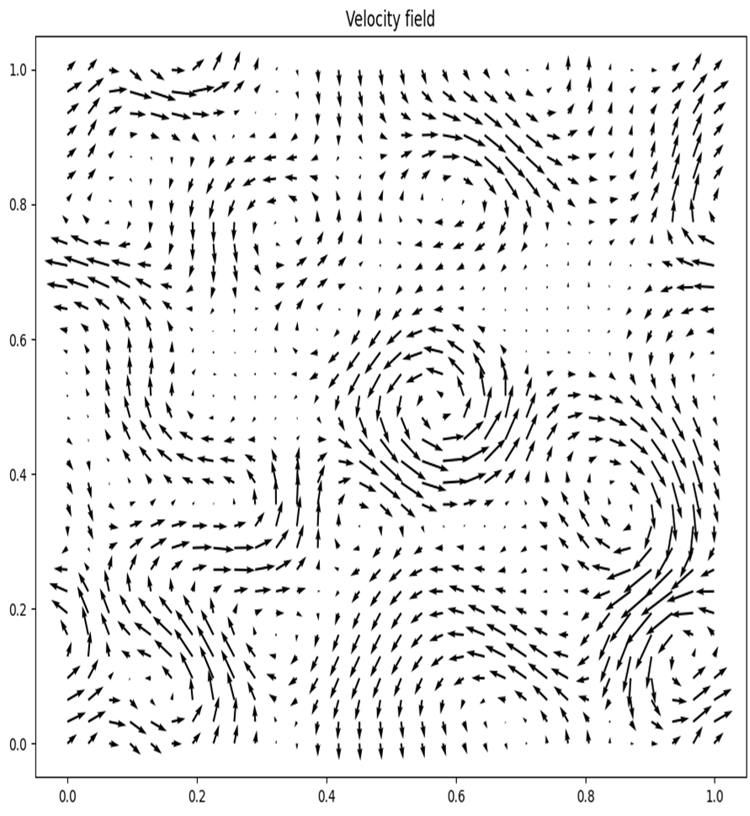
Neural Network Application for PIV Analysis of Steady Fluid Flow
Sashwat Prasadh & Rebecca Ralph
Supervisors: Dr. J Fitzgerald & Dr. J Wheeler
Undergraduate Physics Symposium, August 16, 2024

Slide 2
Key Equations in Fluid Dynamics
Continuity Equation (Conservation of Mass)
∂ρ/∂t + ∇·(ρv) = 0
Bernoulli's Equation (Conservation of Energy)
P + 1/2ρv² + ρgy = constant
Navier-Stokes Equations
(Conservation of Momentum)
∇·v = 0 (continuity equation)
∂v/∂t + v·∇v = -1/ρ ∇p + ν ∇²v
(momentum equation)
Vorticity Equation (Fluid Rotation)
∂ω/∂t + v·∇ω = ω·∇v
Prandtl's Boundary Layer Equation
(Boundary Layer Flow)
∂²v/∂y² = ν * ∂v/∂x
Darcy-Weisbach Equation (Pressure Drop)
ΔP = f * L * ρ * v² / (2 * D)
Geostrophic Balance Equation
(Atmospheric and Oceanic Flows)
-fv = -1/ρ ∂p/∂x
Euler's Equation (Inviscid Flow)
∂v/∂t + v·∇v = -1/ρ ∇p

Slide 3
Key Equations in Fluid Dynamics
Continuity Equation (Conservation of Mass)
∂ρ/∂t + ∇·(ρv) = 0
Bernoulli's Equation (Conservation of Energy)
P + 1/2ρv² + ρgy = constant
Navier-Stokes Equations
(Conservation of Momentum)
∇·v = 0 (continuity equation)
∂v/∂t + v·∇v = -1/ρ ∇p + ν ∇²v
(momentum equation)
Vorticity Equation (Fluid Rotation)
∂ω/∂t + v·∇ω = ω·∇v
Prandtl's Boundary Layer Equation
(Boundary Layer Flow)
∂²v/∂y² = ν * ∂v/∂x
Darcy-Weisbach Equation (Pressure Drop)
ΔP = f * L * ρ * v² / (2 * D)
Geostrophic Balance Equation
(Atmospheric and Oceanic Flows)
-fv = -1/ρ ∂p/∂x
Euler's Equation (Inviscid Flow)
∂v/∂t + v·∇v = -1/ρ ∇p

Slide 4
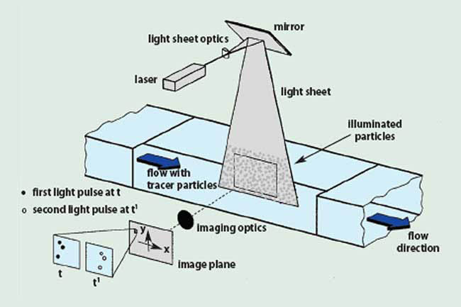
Particle Image Velocimetry (PIV)
Experimental setup
A non-invasive , instantaneous, whole field velocity measurement technique
Study planktonic behavior using turbulence tanks and PIV

Slide 5
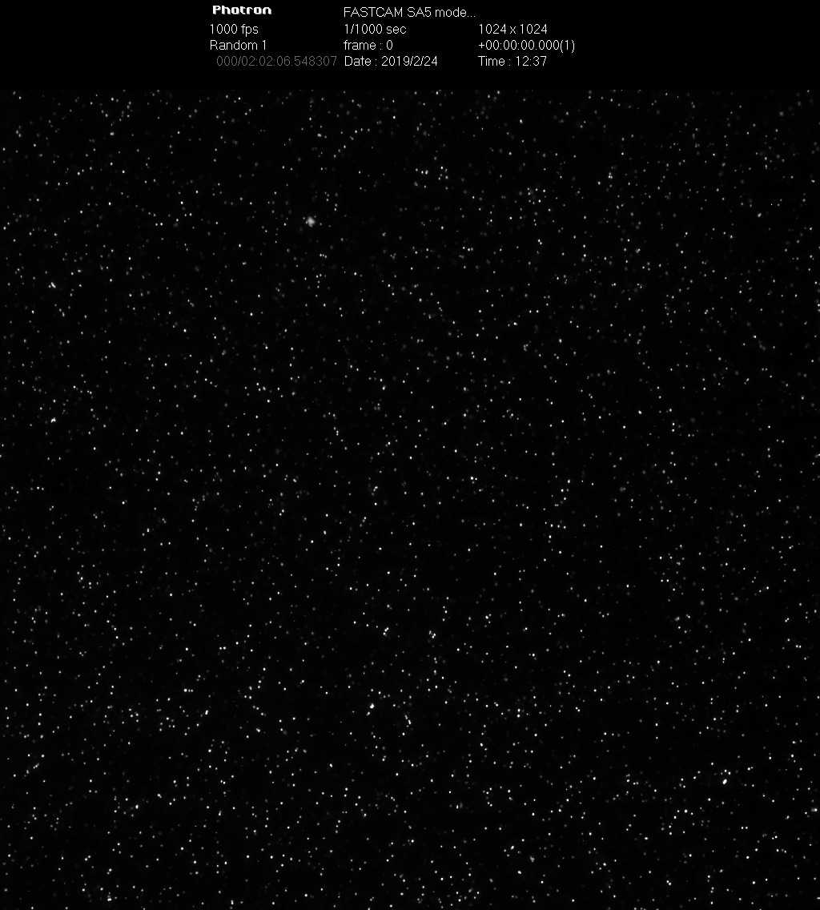
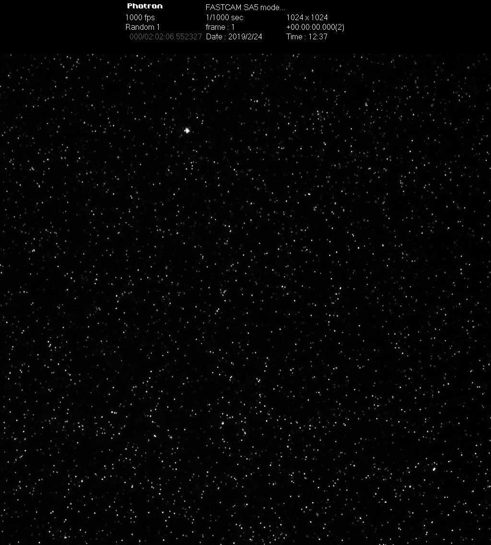
Snapshot 1
Snapshot 2

Slide 6
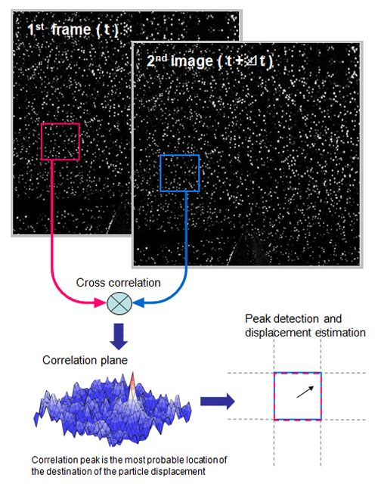
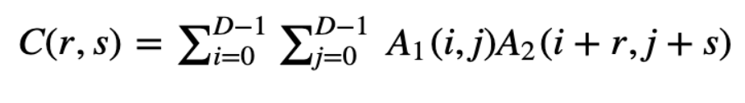
Cross Correlation & Problems
Highest resolution it can achieve is 1 pixel
Does not take any physical equations into account

Slide 7
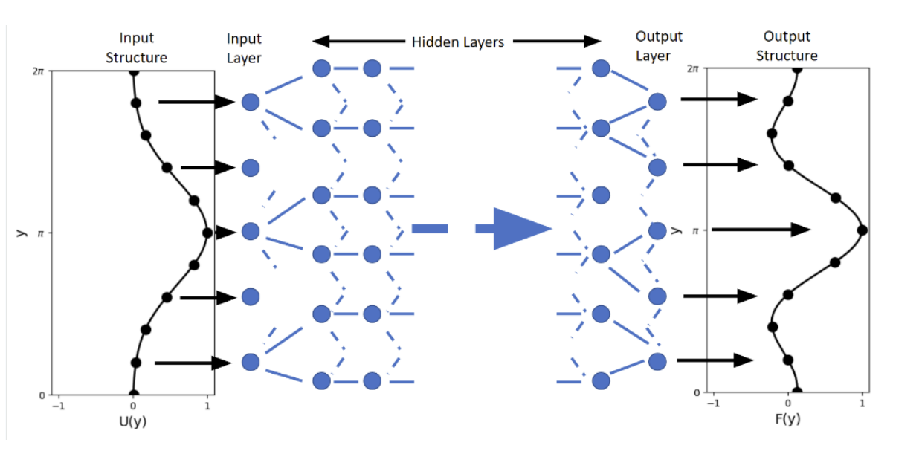
Can a Feedforward or Convolutional Neural Network do a better job?

Slide 8
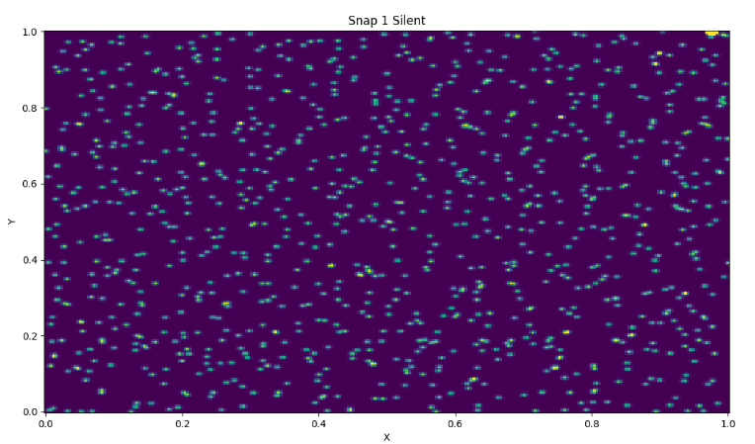

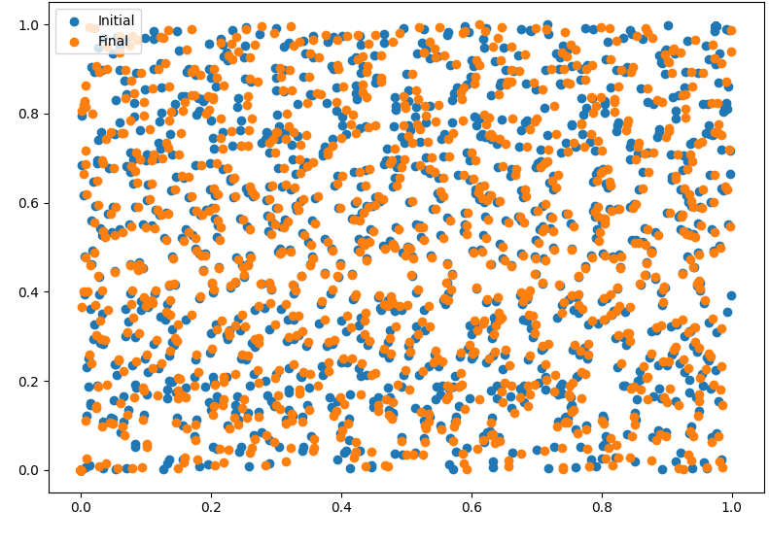
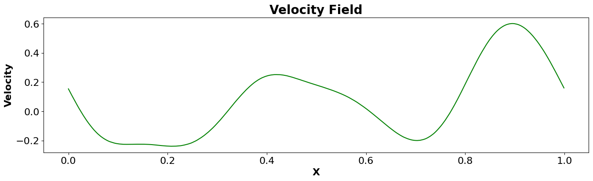
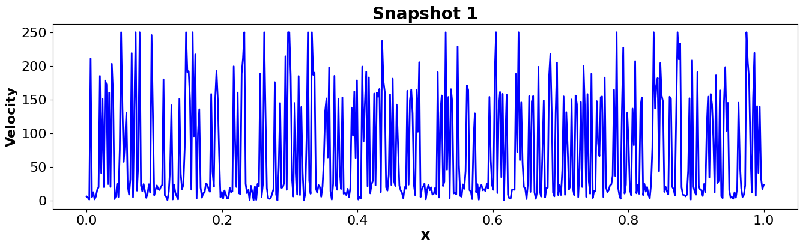
Create Synthetic data & Feed it into PIV, FNN & CNN
A Velocity Field
Snapshot 1
Advect Ideal Particle
2D
1D

Slide 9
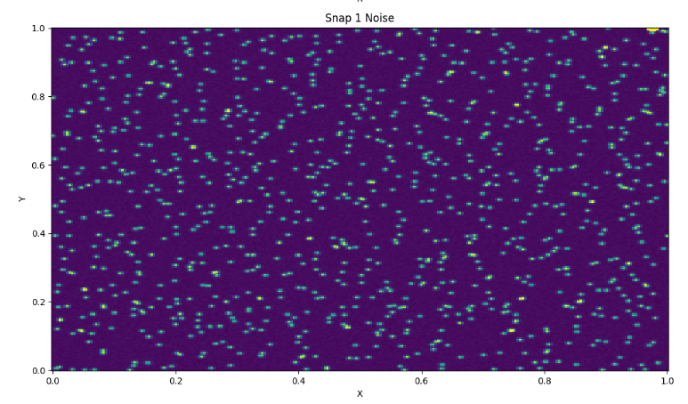
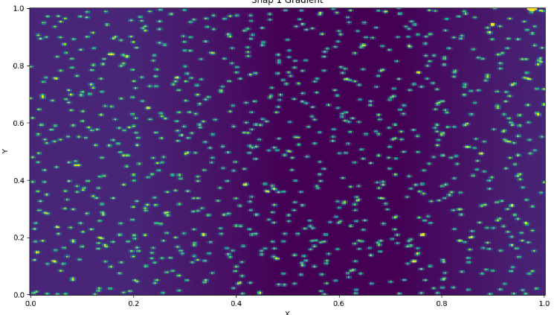
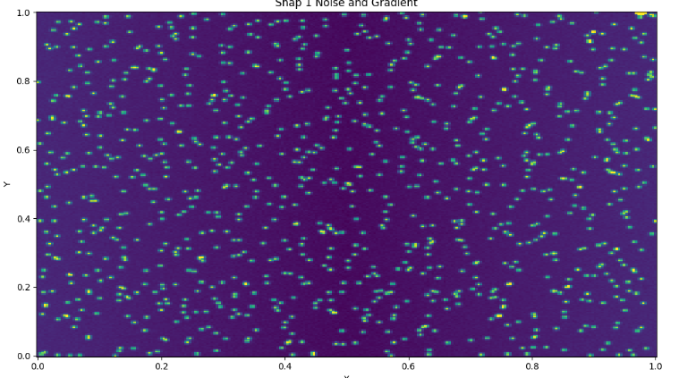
At Various Intensity Levels
Clean (Silent) Snapshot
Noisy Snapshot
Gradient Snapshot
Noise & Gradient Snapshot

Slide 10
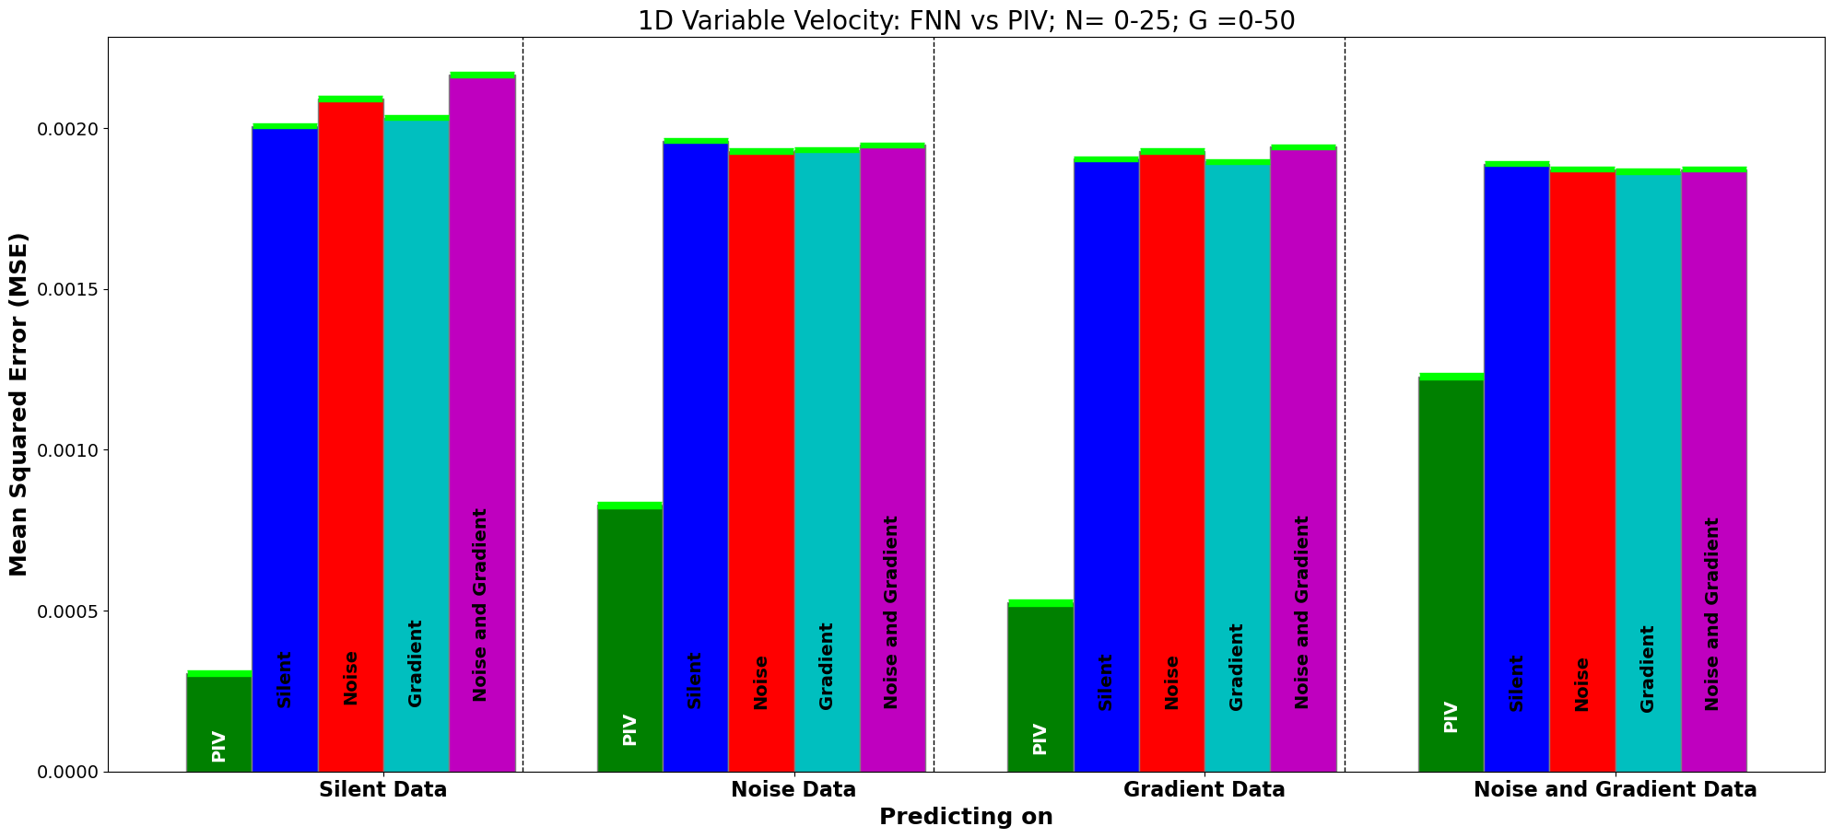
Comparing PIV and FNN’s on different snapshots

Slide 11
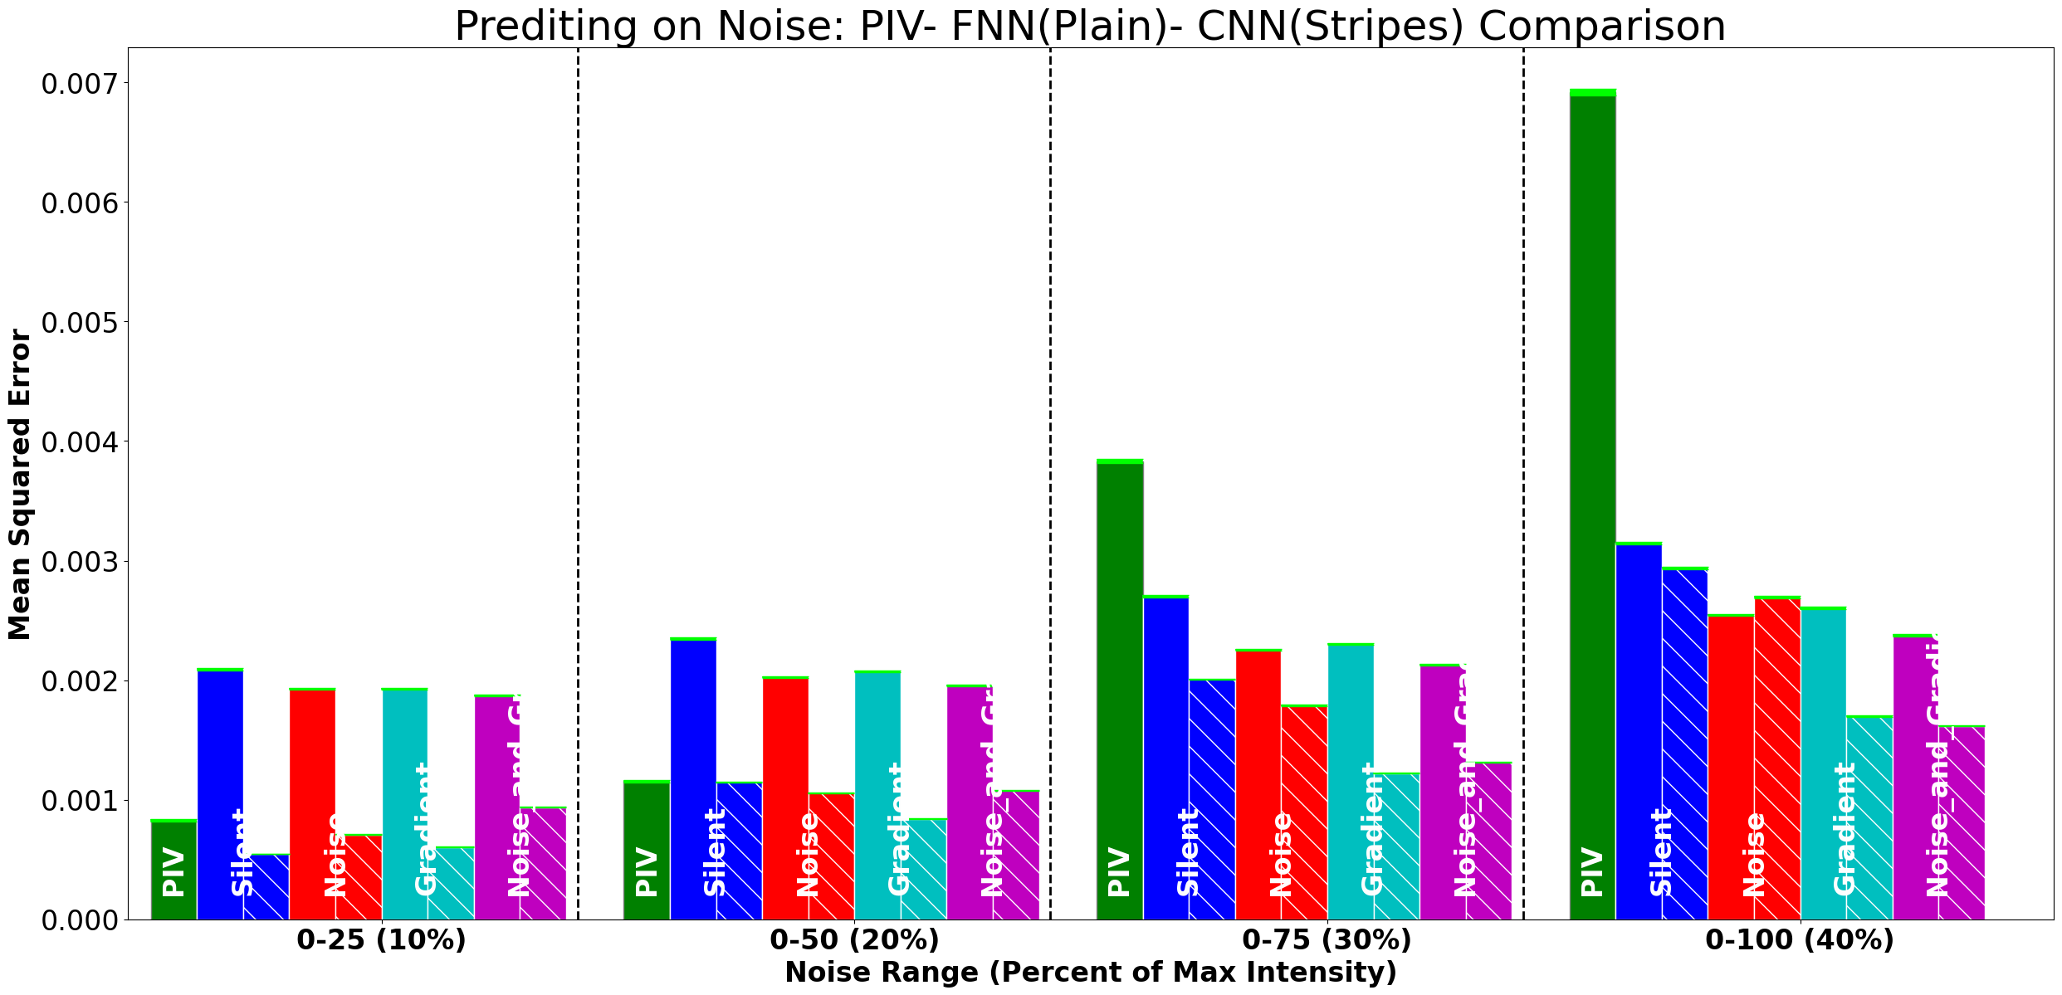

Slide 12
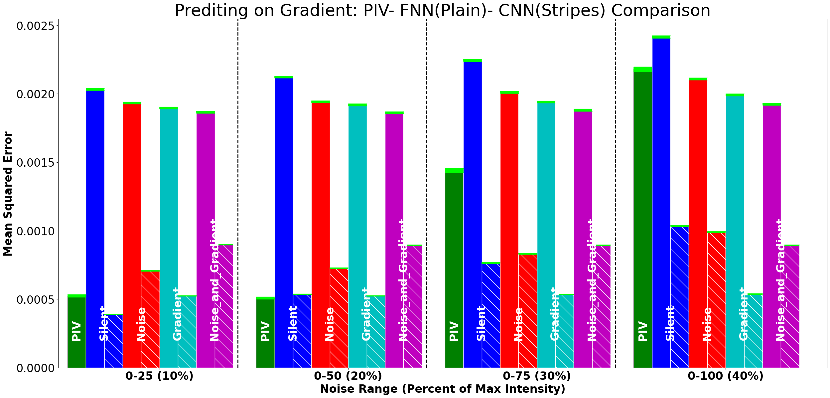

Slide 13
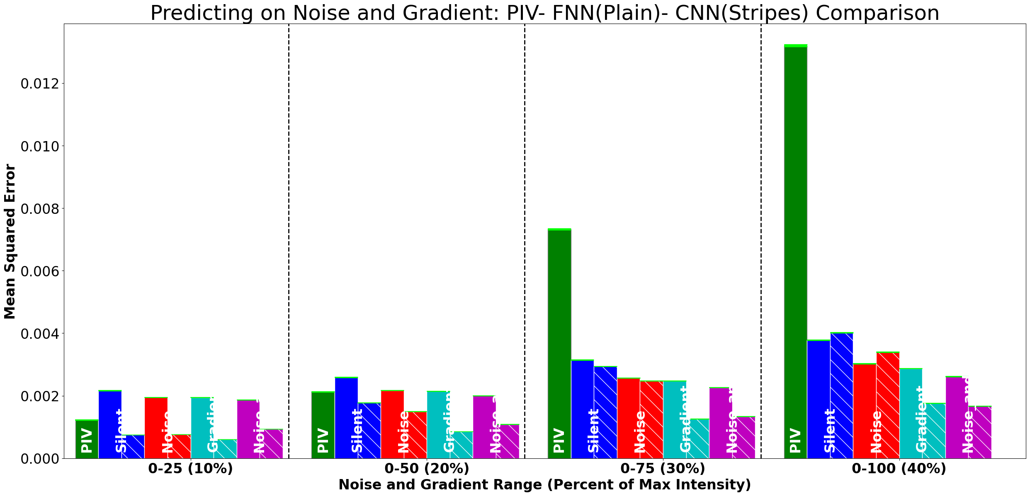

Slide 14
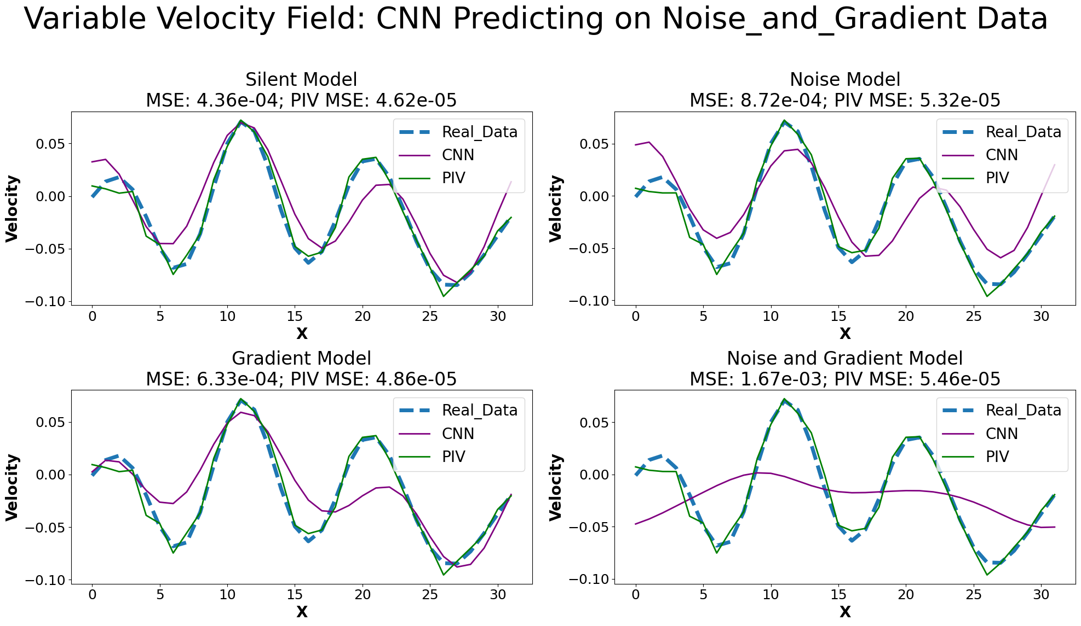
CNN Models Predicting on Corresponding Data
The Caveat

Slide 15
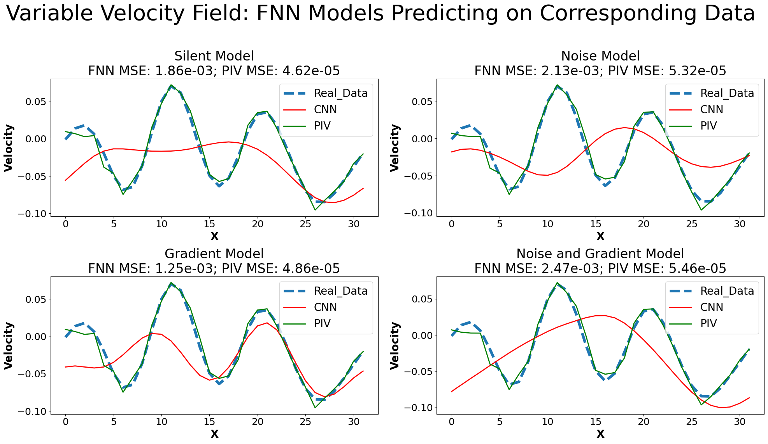
The Caveat

Slide 16
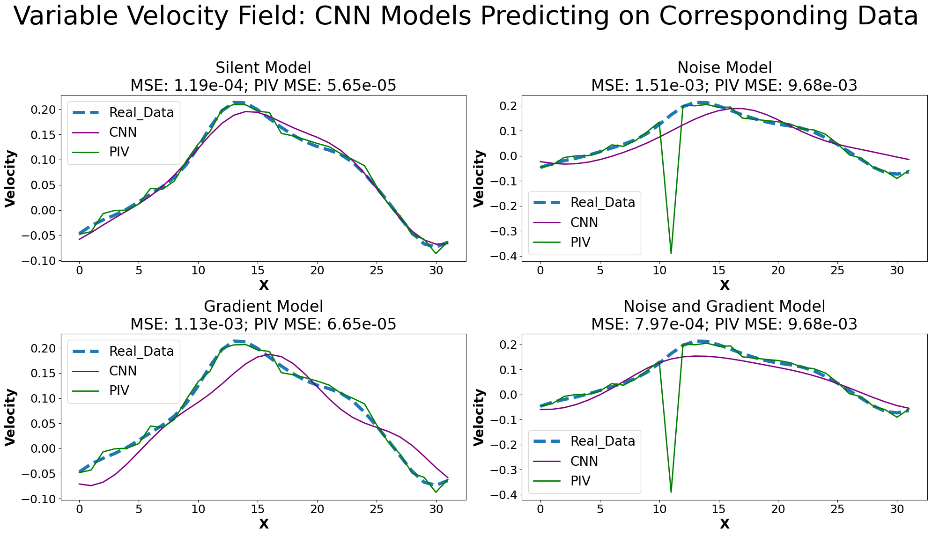
Outliers

Slide 17
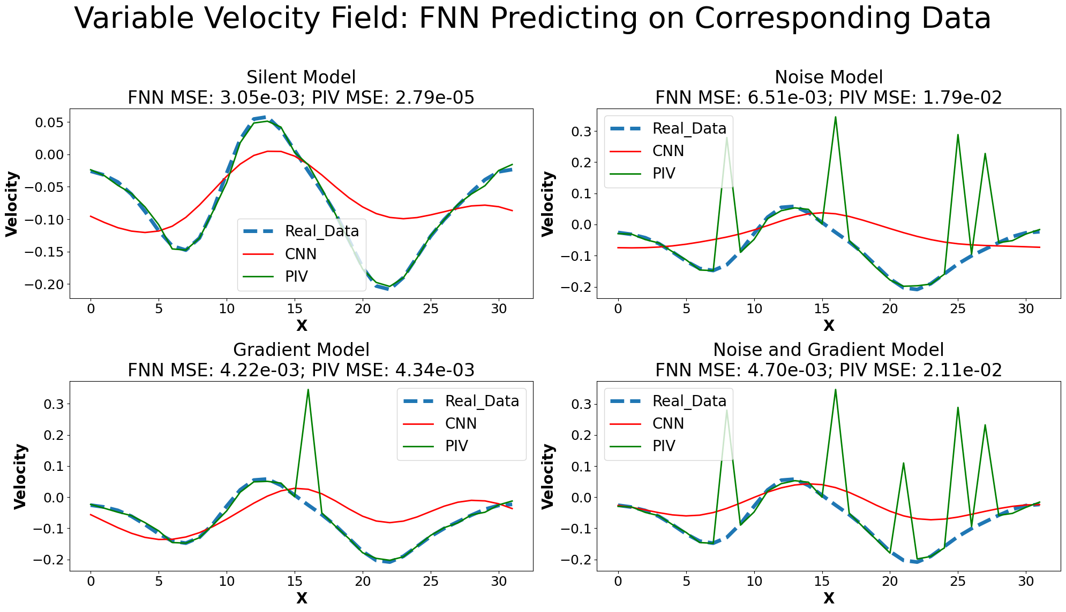
Outliers

Slide 18
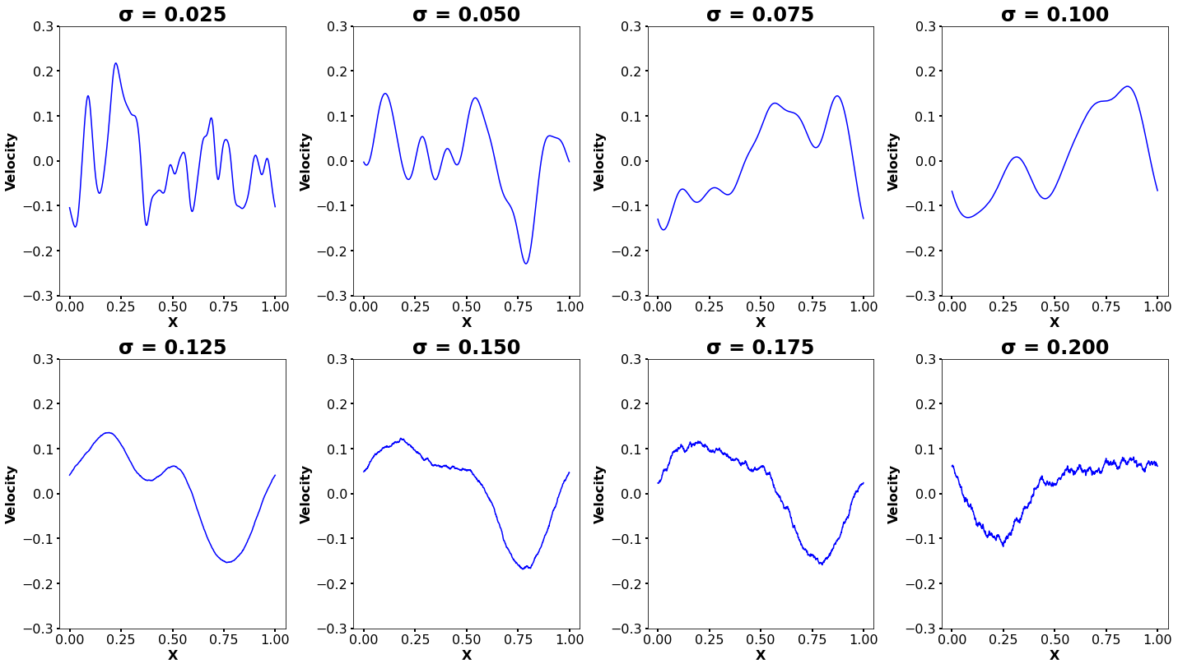
Velocity Fields: Random Flows with Controlled Statistics

Slide 19
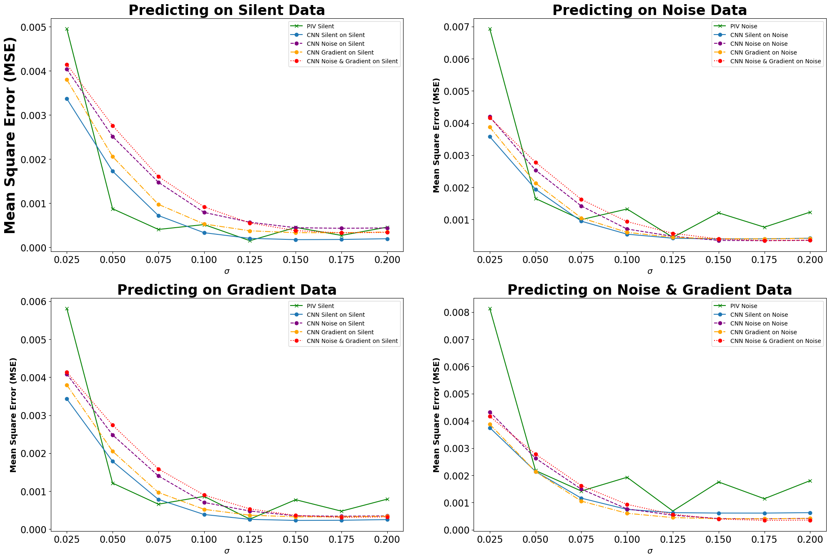

Slide 20
Questions?

Slide 21
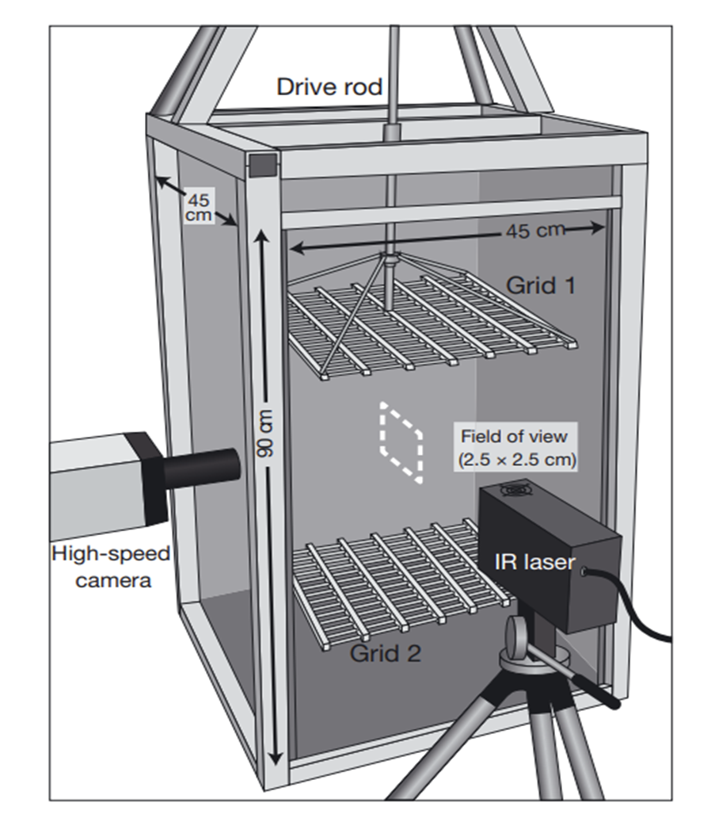

Slide 23
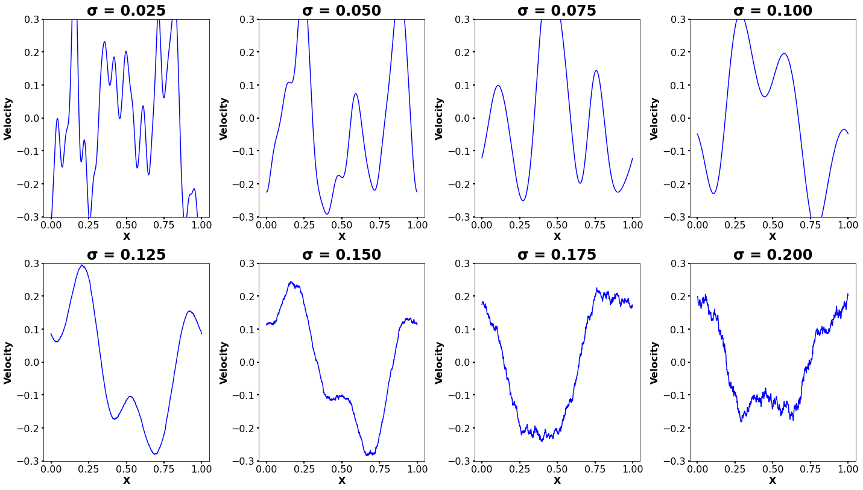

Slide 24
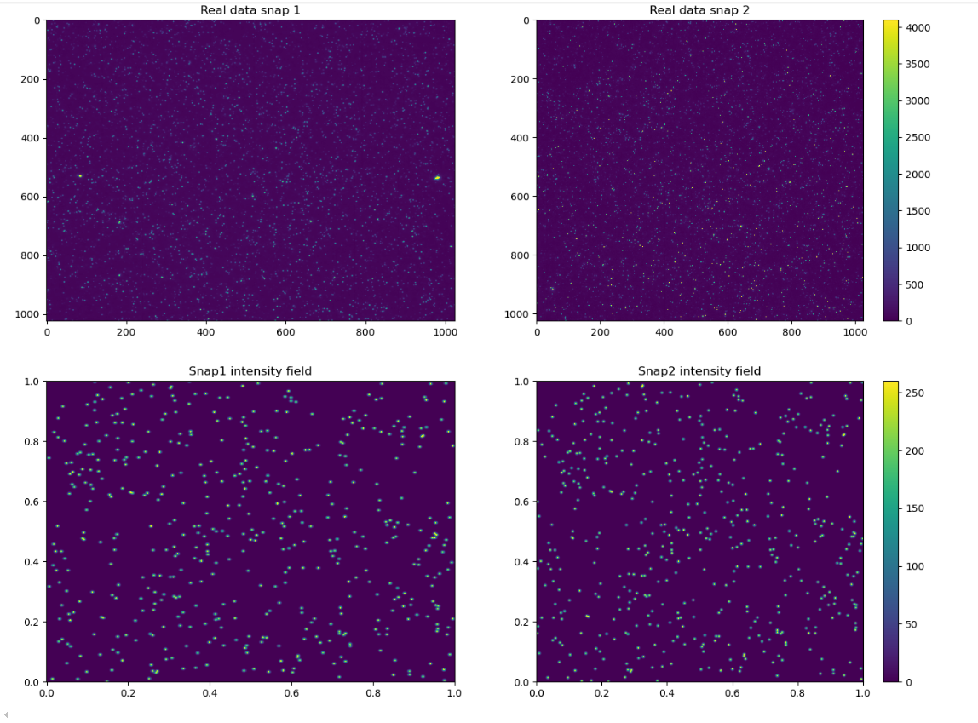

Slide 25
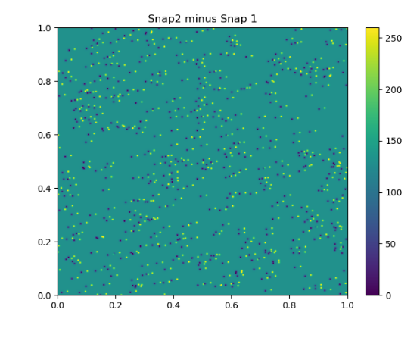

Slide 26
